Slide 1
PLT: Week 11
The problem LR(1) parsing
SLR Parsing
LALR Parsing
Notes:
<νυμβερ>

Slide 2
Tutorial LR(1) Grammar
S -> G r P $
G -> Q
G -> Q a d
Q -> h
P -> g
Create the FSA, goto table, and action table. Show how you would use these tables to parse hadrg$
Notes:
Show we need LR(1) – then get them to do it...
<νυμβερ>

Slide 3
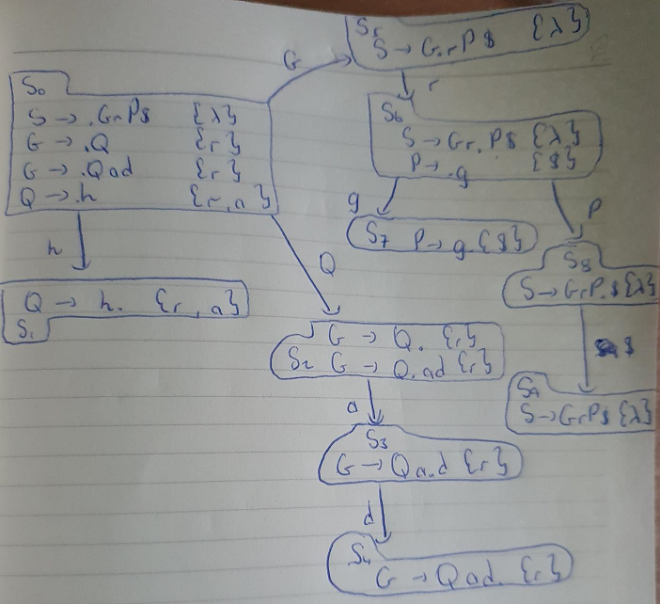
FSA

Slide 4
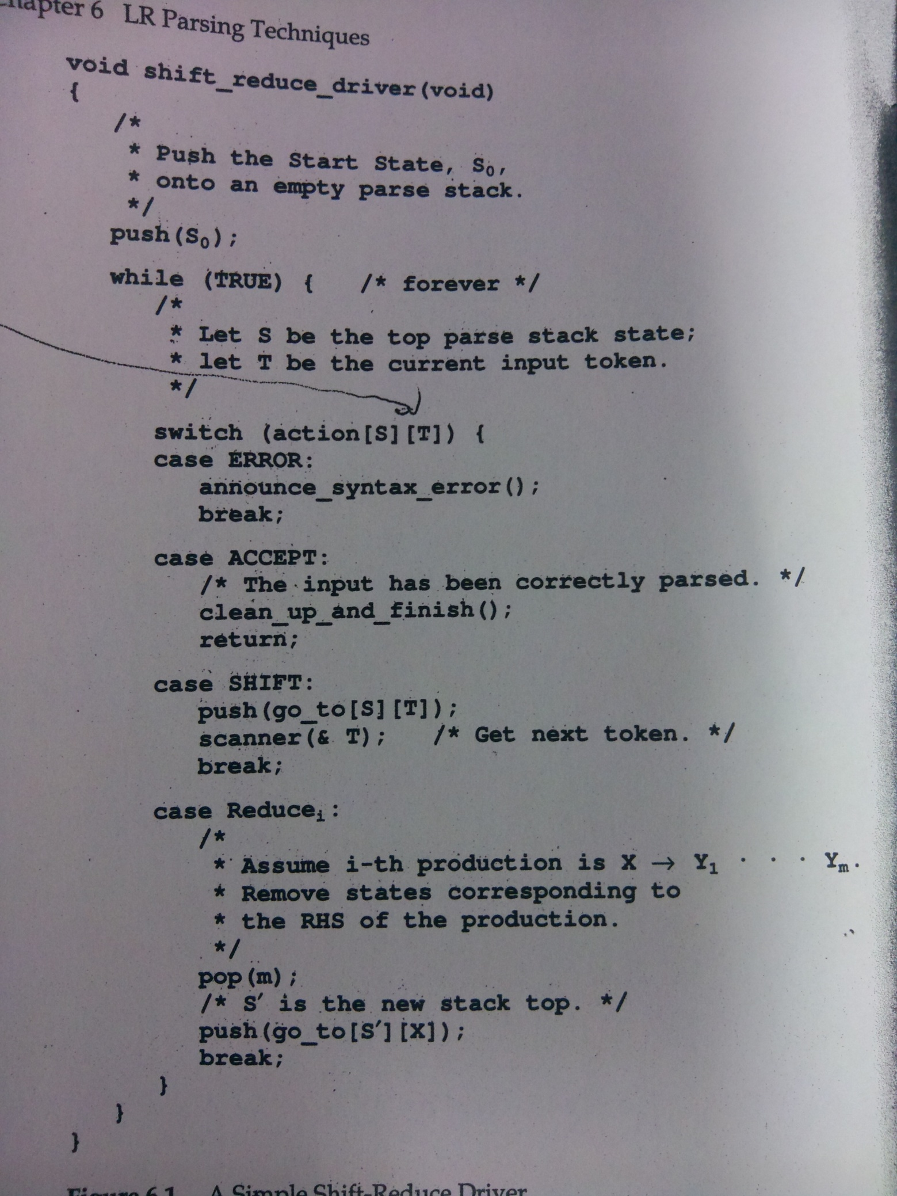
Notes:
Driver code
<νυμβερ>

Slide 5
Seeing Problems on the Horizon (part 1)
Grammar:
  S->.E$ { }
  E->.E+T { }
  E->.T { }
  T->.T*P { }
  T->.P { }
  P->.id { }
  P->.(E) { }
I want you to calculate the lookahead for all the rules in this state

Slide 6
Seeing Problems on the Horizon (part 1)
Grammar:
  S->.E$ {lambda }
  E->.E+T {$, + }
  E->.T {$, + }
  T->.T*P {$,*, + }
  T->.P {$, *, + }
  P->.id {$, +, * }
  P->.(E) {$, +, * }
I want you to calculate the states under the following transitions from S0 (with their lookahead):
  S0 + ‘id’ (call it state 5)
  S0 + ‘(‘ (call it state 6)
  S6 + ‘id’ (call it state 10)

Slide 7
Seeing problems on the Horizon
States can just differ in look-ahead:
  States 5 and 10;
  States 4 and 14;
  States 9 and 22;
  States 13 and 15;
  States 11 and 20;
  States 7 and 19;
  States 8 and 21;
  States 6 and 18;
Depends on context;
Leads to proliferation of states and memory-size issues;

Slide 8
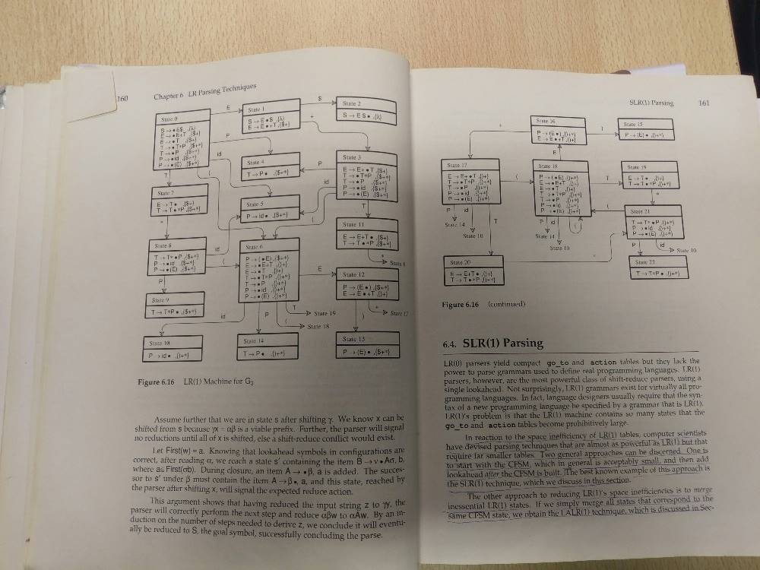

Slide 9
Solution 1: SLR(1)
Build LR(0) Finite State Machine
Look at states with Shift / Reduce conflict
Then calculate the Follow for each LHS of production rules in these states;
Slightly less precise ( first grammar S₇):
  E->T. {$, +, )}
  T->T.*P {$, +, ), *}
  And the problems that might bring...
Notes:
Because slightly less precise, there is a possibility that some LR(1) grammars are not SLR(1)

Slide 10
Slight Limitation with SLR
Grammar
  S-> L=R
  S-> R
  L-> *R
  L-> id
  R->L
  …
Do the S₀ and S₁ under the transition L using the LR(1) FSA
Do the same for the SLR(1) FSA
Spot the problem?
Notes:
Because we use all of Follow(R), we include an = in our look-ahead set in the slr version
But, because the LR(1) FSA knows where it comes from, it knows that = cant be in the follow
<νυμβερ>

Slide 11
The LALR(1) approach
Build the LR(1) FSA;
Merge all states that differ just in their look-ahead:
  Keep the configurations the same;
  Join the look-ahead sets;
  Sometimes gives you a more precise FSA than the SLR;

Slide 12
LALR eg
Grammar:
  S-> S$
  S-> CC
  C-> cC
  C-> d
Build the LR(1) FSM
Build the C -> d. States (towards an LALR FSM)
Why are shift-reduce conflicts rare in LALR?...
Notes:
Parses language instances cdcd$
Note that C->d. {c,d} state will lead to end of first subset of lexical string: cd, and thus will expect new C or d next
Other state C->d. {$, lambda} is reached at the end and so expects nothing else
Can merge C-> .d states with old look-ahead {c,d} and {lambda} leading to new union look-ahead: {c, d, lamda}
Means that we wont detect the error at the state but we will detect it later
Show with ccd$ input for our new FSM.
SR conflicts:
For this to happen we need 2 rules in our merged LALR config set:
P -> alpha . a delta {x, y, z}
Q -> alpha . {a}
But both configs (minus the look ahead) have to be in all states that merge to form this LALR state
And in at least one of them the 2nd config has to have a look ahead of a, suggesting that this was a problem in the original LR(1) FSM – suggesting that the grammar was not LR(1) in the first place.
<νυμβερ>

Slide 13
But not impossible…
Grammar
  S-> P
  P-> aAd
  P-> bBd
  P-> aBe
  P-> bAe
  A-> c
  B -> c
Build the LR(1) FSM showing it is LR(1)
Build the LALR showing it is not LALR.
Notes:
<νυμβερ>

Slide 14
Exam
40% in total
Q1 (20 marks) and 2 others out of 3 (20 marks each);
Q1 will test your knowledge of lex and YACC;
This paper is like maths papers you have faced in the past:
  You test mastery of multiplication by changing the numbers to assess the techniques;
  So trial past exam papers;
  You will be asked to show your knowledge of the techniques.

